Slide 1
Ikram Salah
PhD student

Slide 2
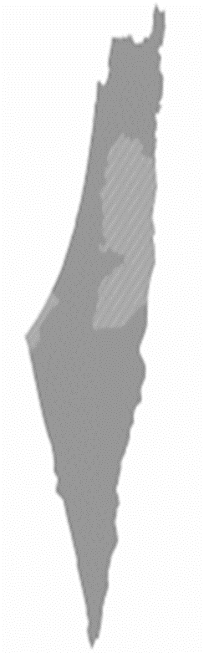
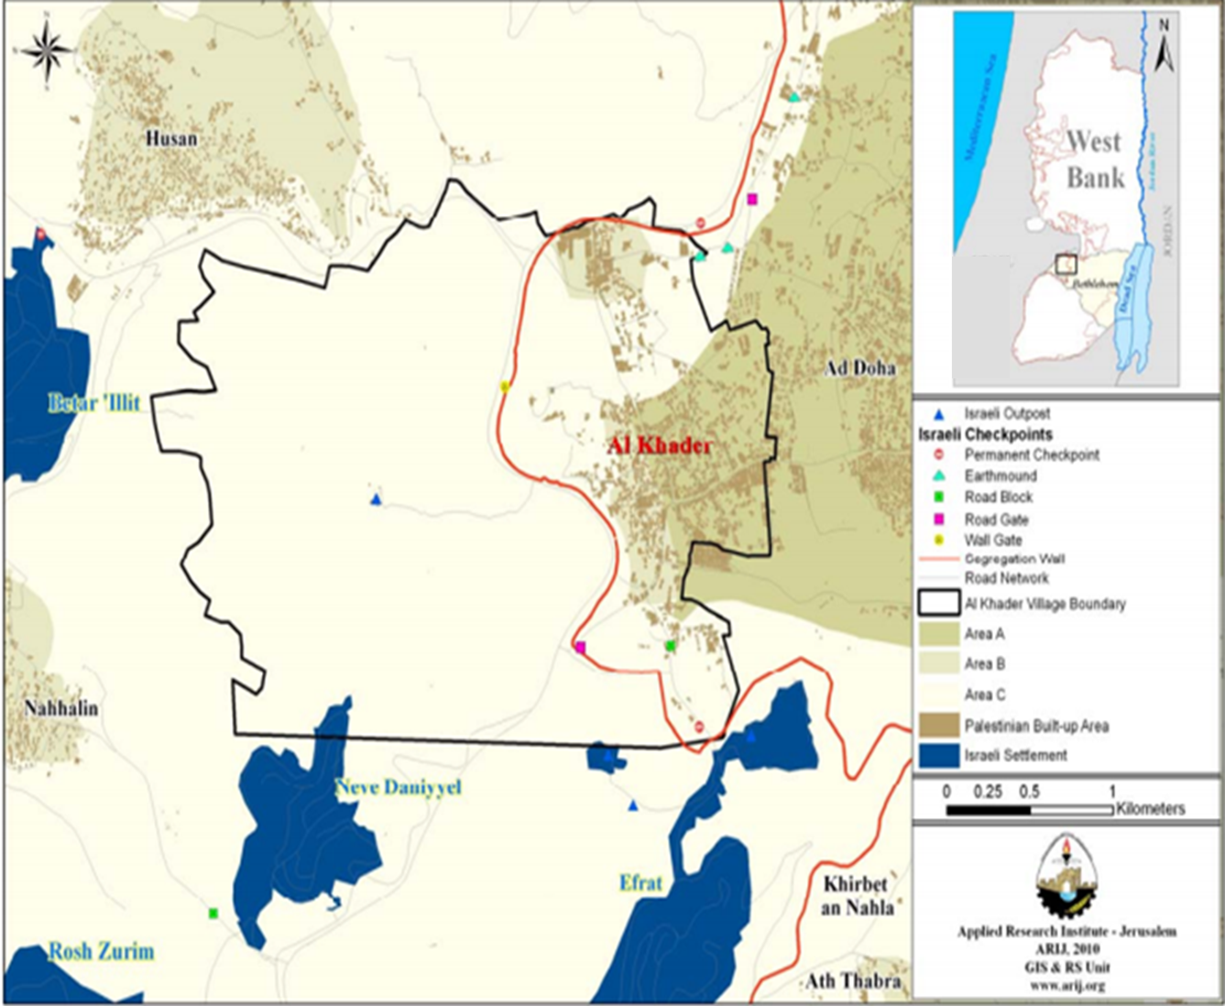
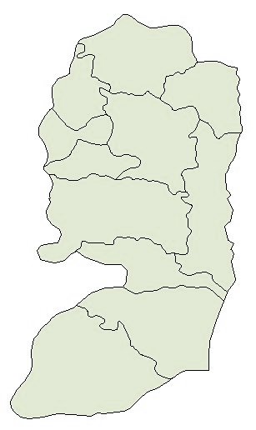
Bethlehem
District

Slide 3

Prof. Burt Kotler Lab
Ben-Gurion University of the Negev
Marco and Louise Mitrani Department of Desert Ecology
The Jacob Blaustein Institutes for Desert Research
Sede Boqer Campus
Beer Sheva

Slide 4
Palestinian researcher
Ecology
Epidemiology
Entomology
Molecular Biology
Long term scientific goal

Slide 5
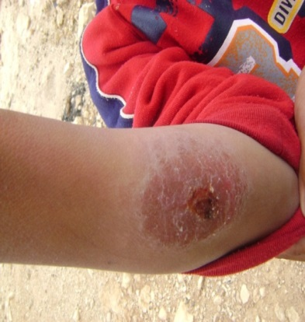
Disease Ecology and Epidemiology of Cutaneous Leishmaniasis (CL) caused by Leishmania tropica in Palestine
Does L. tropica morbidity will be higher in humans with more contact with the vector or with the proximity of reservoir colonies?

Slide 6
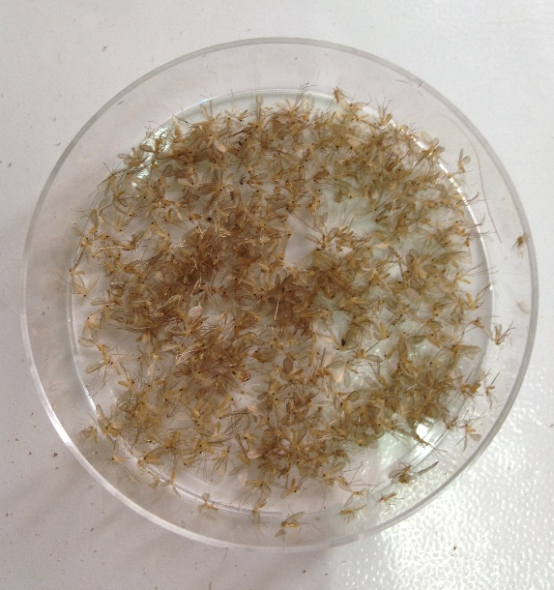
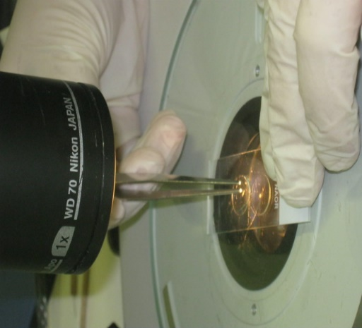
Unique skill that someone else might benefit from
Sand fly identification
In Palestine we have only one person who knows how to identify sand fly, I’m the second one

Slide 7
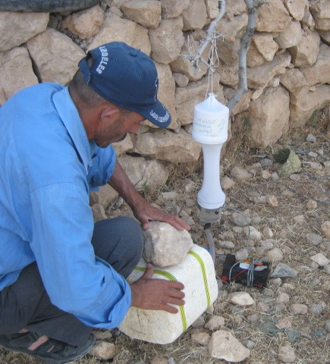
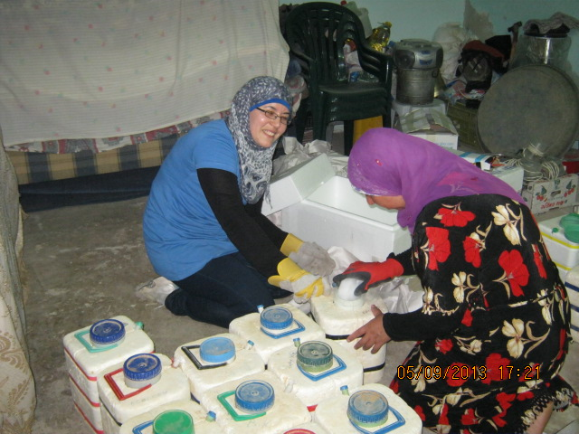
Difficulties in doing research in local area
Permits to work in our areas ☹
Fund ?? (MERC)
Limited equipment
Middle East Regional Cooperation

Slide 8
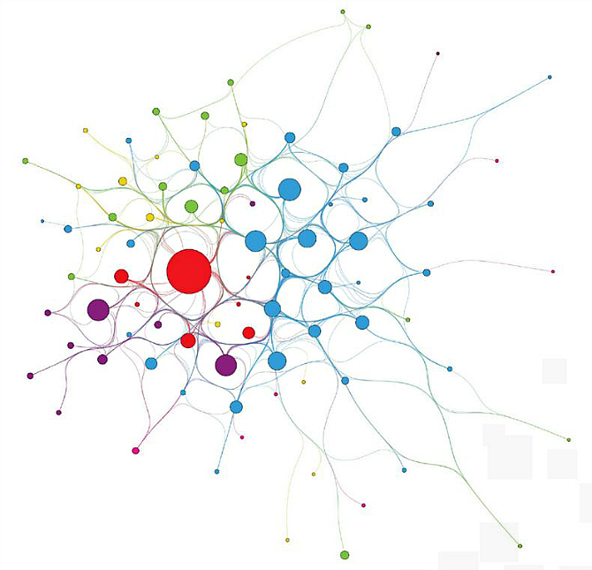
Create a research network

Slide 9

Post doc position

Slide 10
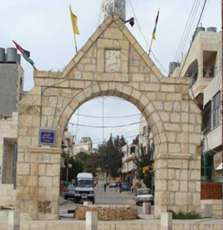
Thank you
شكرا

